Slide 1

Instructions
Welcome to our first online training session!
Please read through this deck in advance of next week’s session and complete the activity on multitasking.
On some slides you will see an icon - please click to hear more.
Next week’s session will be an interactive video call which will test your understanding of the material!

Slide 2
Introduction to Agile

Slide 3


AGILE
Scrum
Lean Software Development
Kanban
XP (Extreme Programming)
Crystal Clear
….
CI (Continuous Integration)
CD (Continuous Deployment)
FDD (Feature Driven Development)
TDD (Test Driven Development)
...
Notes:
Agile Development” is an umbrella term for several iterative and incremental software development methodologies. The most popular agile methodologies include Extreme Programming (XP), Scrum, Kanban, Lean Development, and Feature-Driven Development (FDD).
While each of the agile methodologies is unique in its specific approach, they all share a common vision and core values ( the Agile Manifesto).
They all incorporate iteration and continuous feedback to successively refine a software product
.
They all involve continuous planning, continuous testing, continuous integration, and the continuous evolution of the software.
They are all lightweight, especially compared to traditional waterfall-style processes, and inherently adaptable.
The important part about agile methods is that they all focus on empowering people to collaborate and make decisions together quickly and effectively.

Slide 4
Agile Software Development
Based on the concept of iterative development
Collaboration - Key ingredient which refines requirements and solutions between self-organizing cross-functional teams
A disciplined project management process that encourages frequent inspection and adaptation
A leadership philosophy that encourages teamwork, self-organization and accountability
A set of engineering best practices intended to allow for rapid delivery of high-quality software
A business approach that aligns development with customer needs and company goals

Slide 5
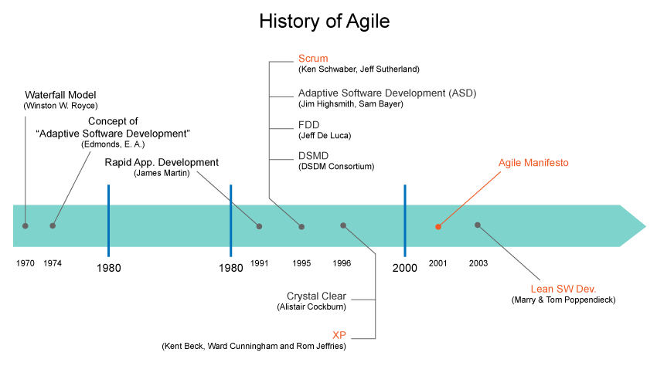
History of Agile
Notes:
Although the roots of Agile may go back to the 50's Test Driven Development with Project Mercury, things really began to pickup in the early 90's with James Martin's RAD (Rapid Application Development). Then things picked up in the mid-90's with the advent of RUP (Rational Unified Process) and Scrum, followed by XP (Extreme Programming) in the late 90's. but the real watershed moment for the Agile movement was the publication of The Manifesto for Agile Software Development in 2001 by a group of 17 software developers, who met to discuss the collection of lightweight development methods, which is now referred to as Agile methods.
1974 - An adaptive software development process documented
1991 - "Rapid Application Development" published
1995 - DSDM Framework published
1995 - SCRUM presented at OOPSLA
1996 - XP Practices developed on C3 project
1997 - FDD processes designed by Jeff De Luca
1999 - FDD described in "Java Modeling in Color with UML"
1999 - "Extreme Programming Explained" published
1999 - "Adaptive Software Development" published
2001 - Crystal Light methodologies described in Cutter IT Journal,
2001 - Agile Manifesto written
2003 - "Lean Software Development: An Agile Toolkit for Software Development Managers" published

Slide 6
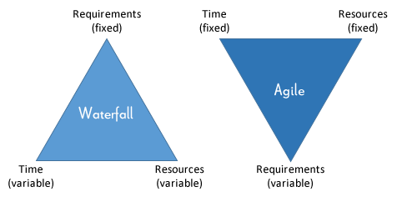
Waterfall vs Agile

Slide 7
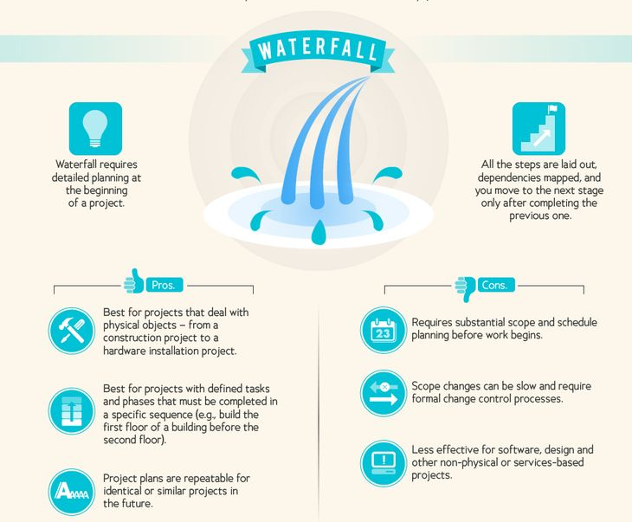
Waterfall

Slide 8
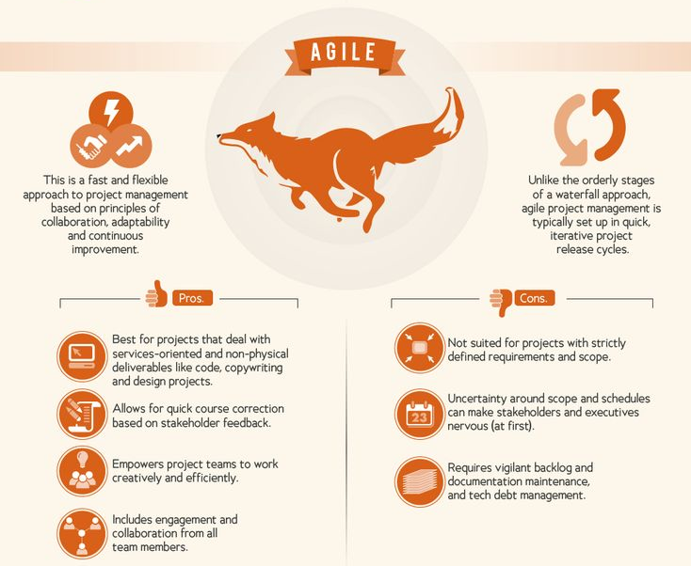
Agile

Slide 9
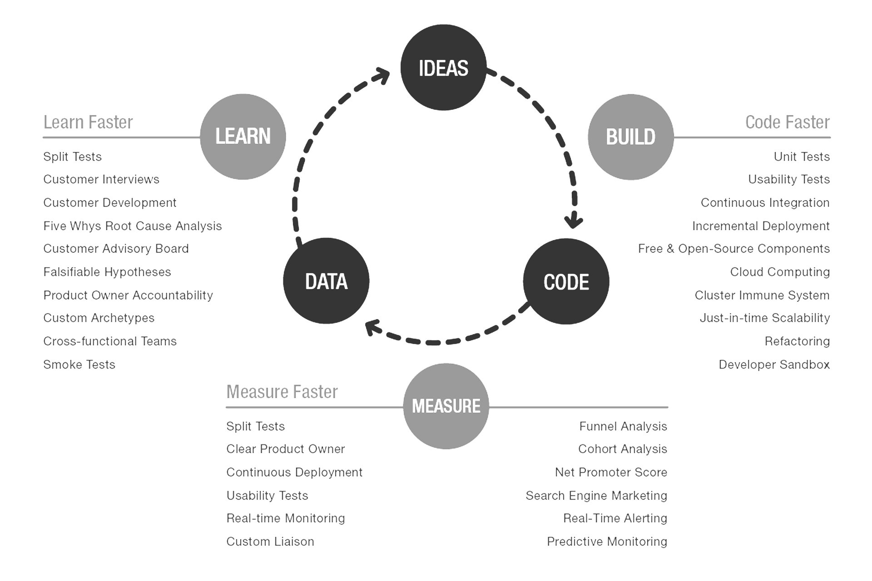
MVP
“MVP is the fastest way to get through the Build –Measure – Learn feedback loop with the minimum amount of effort.”
Eric Ries, The Lean Start-up

Slide 10
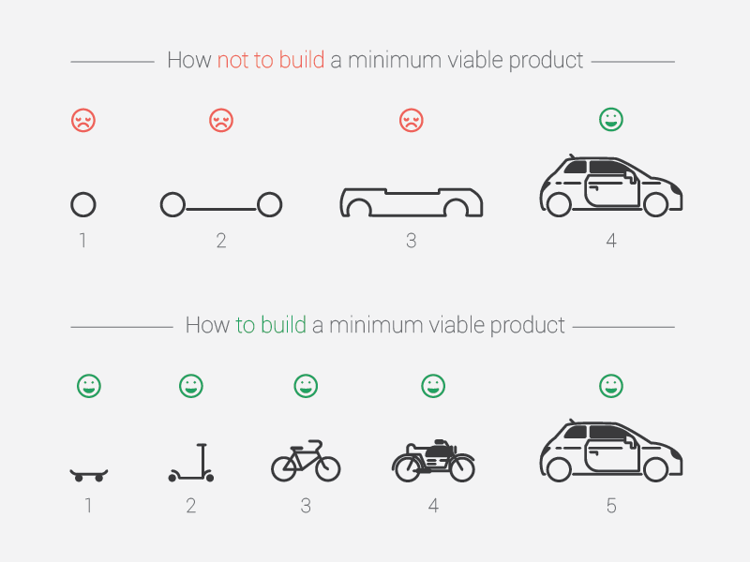
MVP
Notes:
With the MVP remember the following:
•Customers don’t know what you haven’t delivered
They are happy they are getting something
•Quick to market and early feedback
However we should also consider the MMP - Minimum Marketable Product. You need to strike a balance and find the point where…If the feature is any smaller it wouldn’t be marketable
Marketable means usable. If the UI for a product is so poor it jars the user experience it arguably isn’t marketable.

Slide 11
Agile Manifesto & Principles

Slide 12
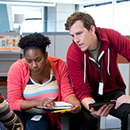



Agile Manifesto
There are 4 key values which are the foundation for agile ways of working.
INDIVIDUALS & INTERACTIONS
Over Processes and Tools
WORKING SOFTWARE
Over comprehensive documentation.
CUSTOMER COLLABORATION
Over contract negotiation
RESPONDING TO CHANGE
Over following a plan
Notes:
Alice
There are 4 key values which underpin the Agile Manifesto.
People deliver solution not process and tools.To provide this solutions both the product team and developers must work together daily throughout the project. It’s not that processes are not helpful. But ultimately if there is a capability issue it will not be solved by implementing a checklist=klok
Ol okloi09o9 h=-
Customers value more getting to experience the software than reading about the software. Getting a product into the customers hand creates an opportunity for learning and making adjustments.Working software is the primary measure of success.
Customers, stakeholders and team members collaborate with each other to find the best way to build and deliver the software. This is not about working in isolation or according to a previously defined written contract.
4. In our technology is moving fast. It’s not possible for companies to remain stagnant and survive. Therefore in order to keep up with changing customer needs we need to be able to change direction if required.

Slide 13
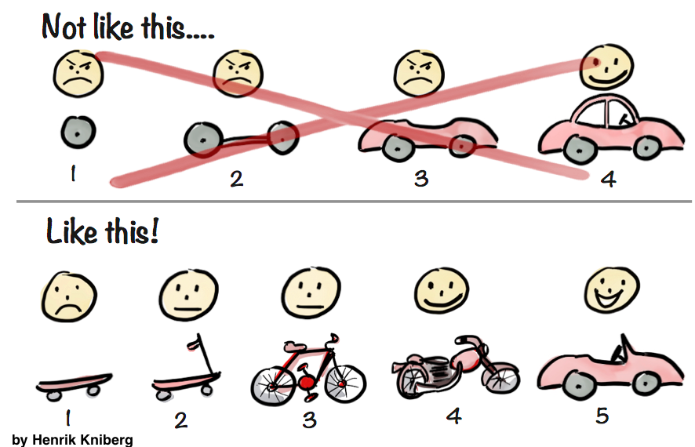
EARLY AND CONTINUOUS DELIVERY OF VALUABLE SOFTWARE
Customers are satisfied when there is:
Early delivery of products to customer for testing and feedback
Continuous delivery to let customers know the progress
Delivery of values to the customers by fulfilling the top priority requirements first
The output of each iteration is working code that can be used to evaluate and respond to changing and evolving user requirements.
Notes:
Grace’s section
Principles behind the Agile Manifesto

Slide 14

WELCOME CHANGE
As well as welcoming change there needs to be responsiveness to change
You can implement changes now -- you don’t need to wait for the next system to be built or a system redesign
Shorten the distance between conceiving and implementing an important change. And even if it’s late in the development process, don’t be afraid to make a shift.
This enhances competitive advantage to emerging opportunities

Slide 15
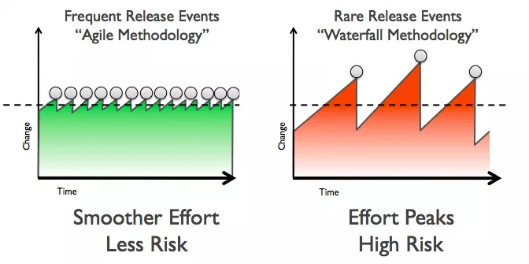
DELIVER WORKING SOFTWARE FREQUENTLY
Delivering frequently provides immediate value to the customer
It is the role of the team to make sure each feature is fully developed, tested and accepted by the product owner before stating it as delivered
The project team activities are structured within a sprint to focus on delivery of value
So, focus more on delivering rather than just planning for delivery. This gives you the opportunity to improve the efficiency and effectiveness of the work

Slide 16
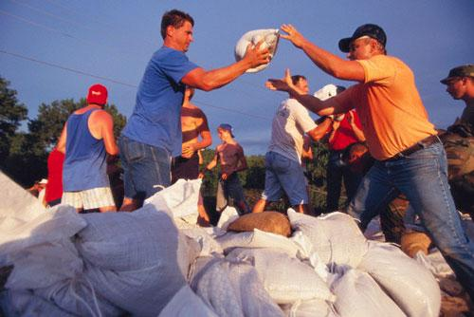
WORKING TOGETHER
This one is crucial, especially because it doesn’t come naturally to most people
Co-location between business people and developers is usually the best way to handle this
Use communication tools for remote workers
Communication helps the two sides better understand each other and leads to more productive work

Slide 17
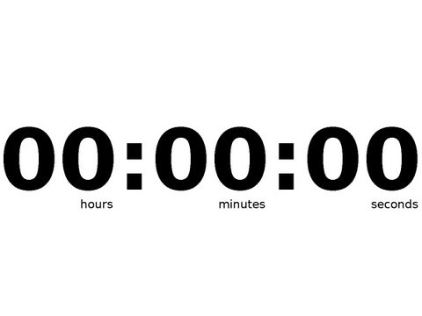
Multi-tasking
Take a blank piece of paper and draw three columns.
Below is a series of numbers of numbers letters and roman numerals
Your job is to copy out the numbers, letters and roman numerals in the following pattern..
Example: A 1 I
B 2 …..
Time yourself against the clock
Numbers | Letters | Roman Numerals
1, 2, 3, 4, 5, 6, 7, 8, 9, 10 | A, b, c, d, e, f, g, h, i, j | I, II, III, IV, V, VI, VII, VIII, IX, X
Notes:
Alice
Is everyone ready? Any questions? Ok…. let’s go! Press play on video clock
https://www.agileconnection.com/article/multitasking-evil

Slide 18
Multi-tasking
Turn your piece of paper over and create 3 columns again
Copy down the same numbers, letters and roman numerals but this time do each set sequentially
Example: A
B
C
Time yourself against the clock again.
Numbers | Letters | Roman Numerals
1, 2, 3, 4, 5, 6, 7, 8, 9, 10 | A, b, c, d, e, f, g, h, i, j | I, II, III, IV, V, VI, VII, VIII, IX, X
Notes:
Alice
To end the game you can share the following: One of the key reasons why the agile approaches work is that they allow people and teams to "single task." That is, agile forces us to focus on doing just one smallish thing at a time. Iterations limit the amount of features a team can start, and most teams quickly discover that it is far easier to have each person working on one task at a time. Well-run maintenance teams tend to work on just a few small tasks at one time. Working in small batches is the key innovation of lean manufacturing and lean and kanban software teams. It's a lot easier to get one smallish thing right at a time than it is to get one large thing right or many small things right.
https://www.agileconnection.com/article/multitasking-evil

Slide 19
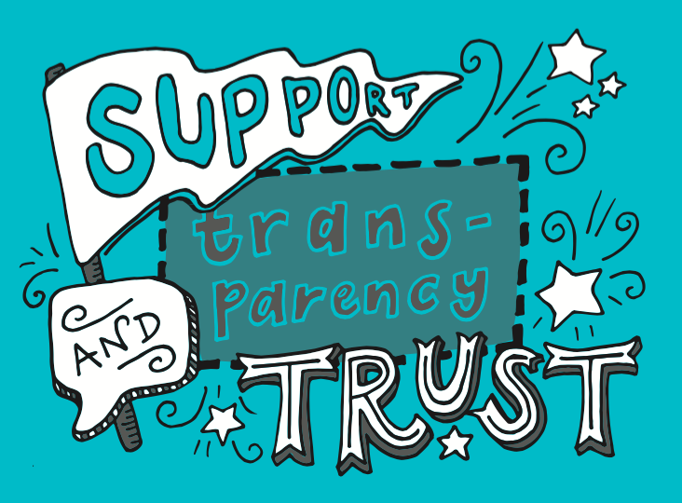
TRUST AND SUPPORT
Products are built by motivated individuals who are given the environment and support they need
Individuals are trusted to get the job done
Team members choose the jobs they are most interested in through self organisation and NOT through external management influence
Micromanagement and top-down approaches to management are not accepted

Slide 20

WORKING SOFTWARE
This is the primary metric an agile development team should be judged by:
Is the software working correctly?
OR
Is the project achieving what we want it to?
Because if it’s not, it doesn’t matter how many words have been typed, bugs have been fixed, hours have been worked, etc.
A good team needs to produce quality products all other measures are pretty much irrelevant if you can’t get it working correctly

Slide 21
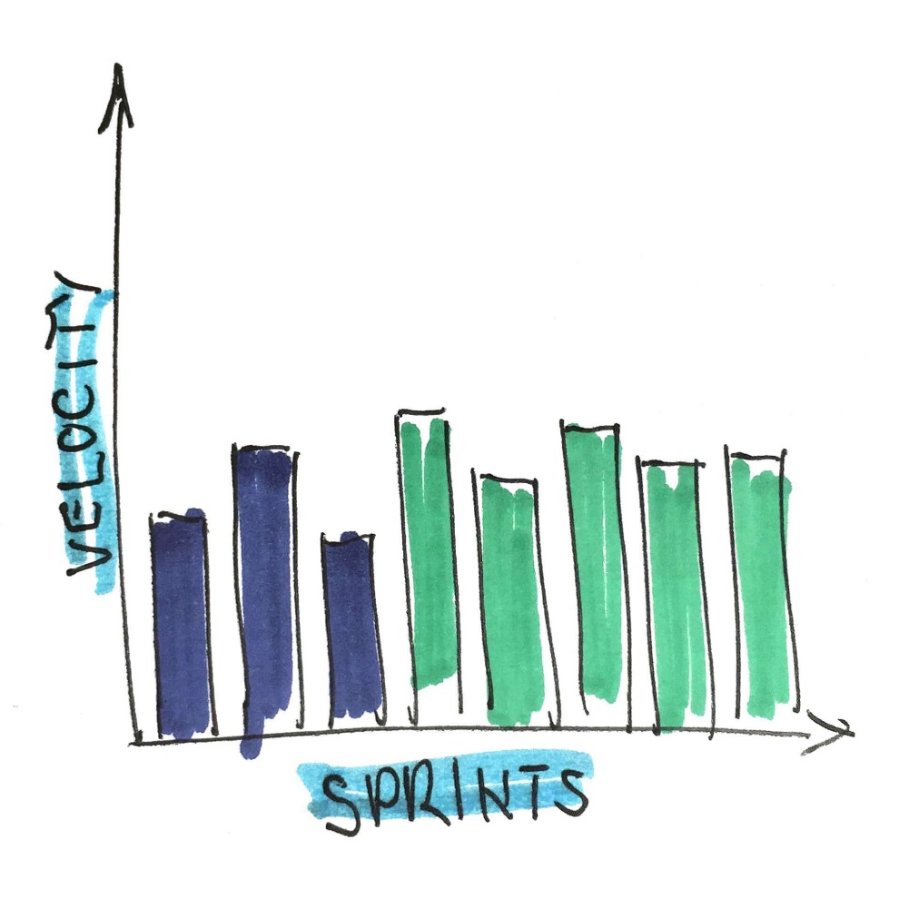
SUSTAINABLE DEVELOPMENT
When working on the same project for a long time, burnout can be a common problem among agile teams.
To prevent this, work should be done in short productive bursts because excessive overtime cannot continue indefinitely without impacting the quality. Focus on choosing the right pace for the team members
Usually, the best pace is one that allows team members to leave the office tired yet satisfied

Slide 22
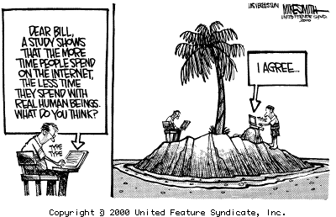
FACE TO FACE COMMUNICATION
Your team should primarily communicate orally for the benefit of osmotic communication
Virtual team conversations should be facilitated via video conferencing where necessary
When obtaining feedback, be sure to go to the source of the problem or confusion to ask for their views
Communication over email should be reduced

Slide 23

MAINTAIN SIMPLICITY
Keep things simple and minimise time between comprehension and completion.
Avoid doing things that don’t matter
Keep focused on what is essential to create value not on distractors
Apply the 80/20 rule. This means typically 80% of your results may come from 20% of your efforts. The idea is to focus on the important 20% of effort that gets the majority of the results

Slide 24
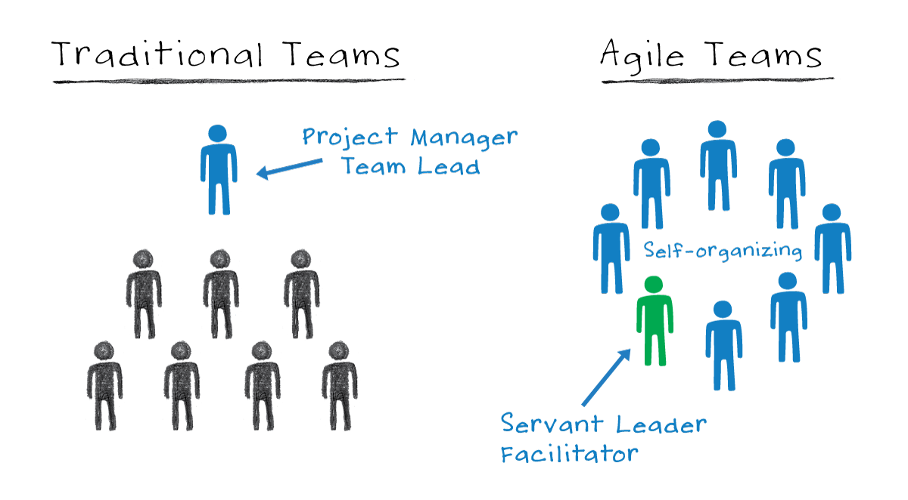
SELF-ORGANISING TEAMS
An agile team should not need to be told what needs to be done.
They tackle problems, clear obstacles and find solutions.
The team have the autonomy and responsibility to meet the goals of the sprint and are responsible for deciding how work will be completed.
Put simply, the team knows best how to carry out the work not the project manager

Slide 25
Self-organising teams
Tightly Managed Teams | Self Organising Teams
Take directions | Take initiative
Seek individual reward | Focus on team contributions
Focus on low-level objectives | Concentrate on solutions
Compete | Co-operate
Stop at pre-set goals | Continuously improve
React to emergencies | Take steps to prevent emergencies

Slide 26
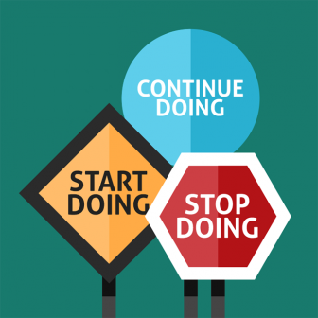
REFLECT AND ADJUST
Just because you’ve done things a certain way for a long time does not mean it is still the best way to do things
At regular intervals the team reflects on how to become more effective, then adjust its behaviour accordingly
Retrospectives enable teams to learn, capture and apply lessons throughout the project lifecycle.
This enables continuous improvement

Slide 27
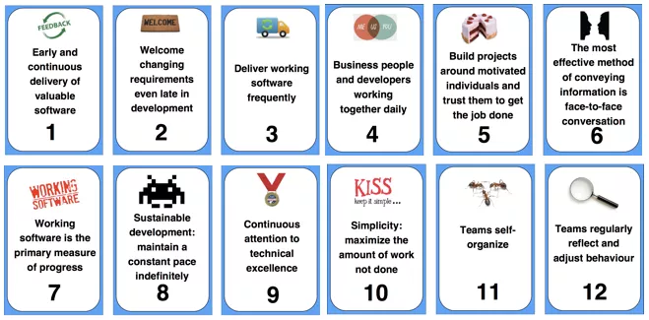
Agile Principles Summary
Notes:
Alice
The core Agile Manifesto values are captured in twelve principles:
Customer satisfaction through early and continuous software delivery - Customers are happier when they receive working software at regular intervals, rather than waiting extended periods of time between releases.
Accommodate changing requirements throughout the development process - The ability to avoid delays when a requirement or feature request changes.
Frequent delivery of working software - Scrum accommodates this principle since the team operates in software sprints or iterations that ensure regular delivery of working software.
Collaboration between the business stakeholders and developers throughout the project - Better decisions are made when the business and technical team are aligned.
Support, trust, and motivate the people involved - Motivated teams are more likely to deliver their best work than unhappy teams.
Enable face-to-face interactions - Communication is more successful when development teams are co-located.
Working software is the primary measure of progress - Delivering functional software to the customer is the ultimate factor that measures progress.
Agile processes to support a consistent development pace - Teams establish a repeatable and maintainable speed at which they can deliver working software, and they repeat it with each release.
Attention to technical detail and design enhances agility - The right skills and good design ensures the team can maintain the pace, constantly improve the product, and sustain change.
Simplicity - Develop just enough to get the job done for right now.
Self-organizing teams encourage great architectures, requirements, and designs - Skilled and motivated team members who have decision-making power, take ownership, communicate regularly with other team members, and share ideas that deliver quality products.
Regular reflections on how to become more effective - Self-improvement, process improvement, advancing skills, and techniques help team members work more efficiently.

